Slide 1
COM2067 / COM267
Chapter 7: Stacks

Slide 2
Introduction to Stacks
Array Representation of Stacks
Operations on a Stack
Linked Representation of Stacks
Operations on a Linked Stack
Multiple Stacks
Application of Stacks

Slide 3
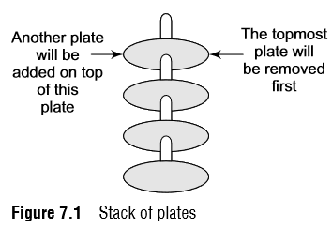
Introduction to Stacks
Stack is an important data structure which stores its elements in an ordered manner.
We will explain the concept of stacks using an analogy.
You must have seen a pile of plates where one plate is placed on top of another as shown in Fig. 7.1.
Now, when you want to remove a plate, you remove the topmost plate first.
Hence, you can add and remove an element (i.e., a plate) only at/from one position which is the topmost position.

Slide 4
Introduction to Stacks
A stack is a linear data structure which uses the same principle, i.e., the elements in a stack are added and removed only from one end, which is called the TOP.
Hence, a stack is called a LIFO (Last-In-First-Out) data structure, as the element that was inserted last is the first one to be taken out.
Now the question is where do we need stacks in computer science?
The answer is in function calls.
Consider an example, where we are executing function A.
In the course of its execution, function A calls another function B.
Function B in turn calls another function C, which calls function D.

Slide 5
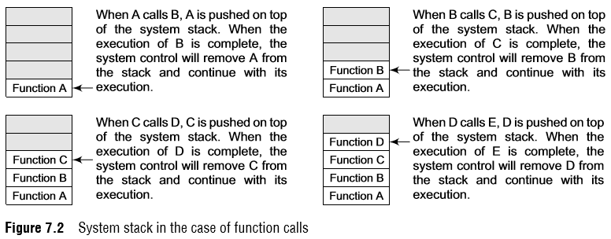
Introduction to Stacks
In order to keep track of the returning point of each active function, a special stack called system stack or call stack is used.
Whenever a function calls another function, the calling function is pushed onto the top of the stack.
This is because after the called function gets executed, the control is passed back to the calling function.
Look at Fig. 7.2 which shows this concept.

Slide 6
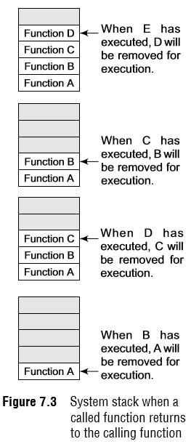
Introduction to Stacks
Now when function E is executed, function D will be removed from the top of the stack and executed.
Once function D gets completely executed, function C will be removed from the stack for execution.
The whole procedure will be repeated until all the functions get executed.
Let us look at the stack after each function is executed.
This is shown in Fig. 7.3. The system stack ensures a proper execution order of functions.
Therefore, stacks are frequently used in situations where the order of processing is very important, especially when the processing needs to be postponed until other conditions are fulfilled.

Slide 7

Array Representation of Stacks
Stacks can be implemented using either arrays or linked lists.
Linear array.
Every stack has a variable called TOP associated with it, which is used to store the address of the topmost element of the stack.
It is this position where the element will be added to or deleted from.
There is another variable called MAX, which is used to store the maximum number of elements that the stack can hold.
If TOP = NULL, then it indicates that the stack is empty and
if TOP = MAX–1, then the stack is full.
The stack in Fig. 7.4 shows that TOP = 4, so insertions and deletions will be done at this position. In the above stack, five more elements can still be stored.

Slide 8
Operations on a Stack
A stack supports three basic operations: push, pop, and peek.
The push operation adds an element to the top of the stack and the pop operation removes the element from the top of the stack.
The peek operation returns the value of the topmost element of the stack.
Push Operation
The push operation is used to insert an element into the stack.
The new element is added at the topmost position of the stack.
However, before inserting the value, we must first check if TOP=MAX–1, because if that is the case, then the stack is full and no more insertions can be done.
If an attempt is made to insert a value in a stack that is already full, an OVERFLOW message is printed.

Slide 9


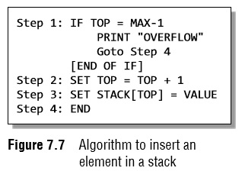
Operations on a Stack
To insert an element with value 6, we first check if TOP=MAX–1.
If the condition is false, then we increment the value of TOP and store the new element at the position given by stack[TOP].
Figure 7.7 shows the algorithm to insert an element in a stack.
In Step 1, we first check for the OVERFLOW condition.
In Step 2, TOP is incremented so that it points to the next location in the array.
In Step 3, the value is stored in the stack at the location pointed by TOP.

Slide 10
Operations on a Stack
Pop Operation
The pop operation is used to delete the topmost element from the stack.
However, before deleting the value, we must first check if TOP=NULL because if that is the case, then it means the stack is empty and no more deletions can be done.
If an attempt is made to delete a value from a stack that is already empty, an UNDERFLOW message is printed.

Slide 11
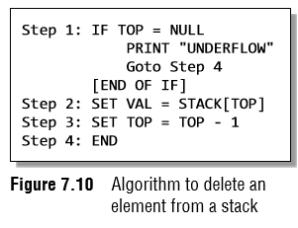


Operations on a Stack
Pop Operation
To delete the topmost element, we first check if TOP=NULL. If the condition is false, then we decrement the value pointed by TOP.
Thus, the updated stack becomes as shown in Fig. 7.9.
Figure 7.10 shows the algorithm to delete an element from a stack.
In Step 1, we first check for the UNDERFLOW condition.
In Step 2, the value of the location in the stack pointed by TOP is stored in VAL.
In Step 3, TOP is decremented.

Slide 12
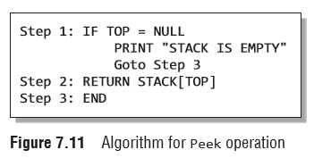

Operations on a Stack
Peek Operation
Peek is an operation that returns the value of the topmost element of the stack without deleting it from the stack.
The algorithm for Peek operation is given in Fig. 7.11.
However, the Peek operation first checks if the stack is empty, i.e., if TOP = NULL, then an appropriate message is printed, else the value is returned.
Consider the stack given in Fig. 7.12.
Here, the Peek operation will return 5, as it is the value of the topmost element of the stack.

Slide 13
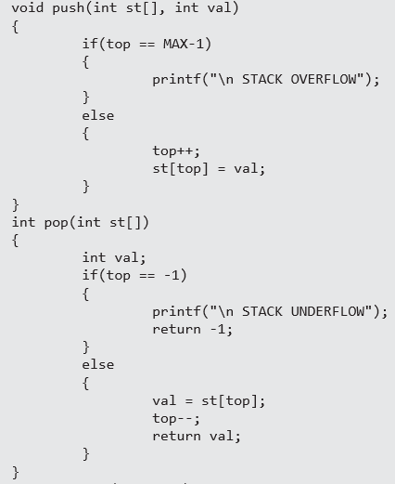
Operations on a Stack

Slide 14
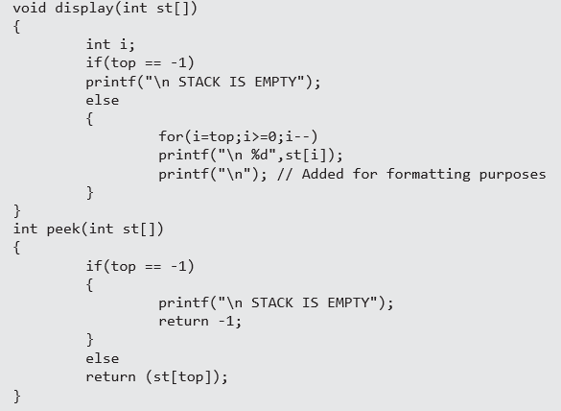
Operations on a Stack

Slide 15
Linked Representation of Stacks
This technique of creating a stack is easy, but the drawback is that the array must be declared to have some fixed size.
In case the stack is a very small one or its maximum size is known in advance, then the array implementation of the stack gives an efficient implementation.
But if the array size cannot be determined in advance, then the other alternative, i.e., linked representation, is used.
The storage requirement of linked representation of the stack with n elements is O(n), and the typical time requirement for the operations is O(1).

Slide 16

Linked Representation of Stacks
In a linked stack, every node has two parts—one that stores data and another that stores the address of the next node.
The START pointer of the linked list is used as TOP.
All insertions and deletions are done at the node pointed by TOP. If TOP = NULL, then it indicates that the stack is empty.
The linked representation of a stack is shown in Fig. 7.13.

Slide 17


Operations on a Linked Stack
Push Operation
The push operation is used to insert an element into the stack.
The new element is added at the topmost position of the stack. Consider the linked stack shown in Fig. 7.14.
To insert an element with value 9, we first check if TOP=NULL.
If this is the case, then we allocate memory for a new node, store the value in its DATA part and NULL in its NEXT part.
The new node will then be called TOP.
However, if TOP!=NULL, then we insert the new node at the beginning of the linked stack and name this new node as TOP.
Thus, the updated stack becomes as shown in Fig. 7.15.

Slide 18
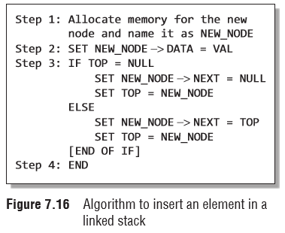
Operations on a Linked Stack
Figure 7.16 shows the algorithm to push an element into a linked stack.
In Step 1, memory is allocated for the new node. In Step 2, the DATA part of the new node is initialized with the value to be stored in the node.
In Step 3, we check if the new node is the first node of the linked list.
This is done by checking if TOP = NULL.
In case the IF statement evaluates to true, then NULL is stored in the NEXT part of the node and the new node is called TOP.
However, if the new node is not the first node in the list, then it is added before the first node of the list (that is, the TOP node) and termed as TOP.

Slide 19
Operations on a Linked Stack
Pop Operation
The pop operation is used to delete the topmost element from a stack.
However, before deleting the value, we must first check if TOP=NULL, because if this is the case, then it means that the stack is empty and no more deletions can be done.
If an attempt is made to delete a value from a stack that is already empty, an UNDERFLOW message is printed.
In case TOP!=NULL, then we will delete the node pointed by TOP, and make TOP point to the second element of the linked stack.

Slide 20
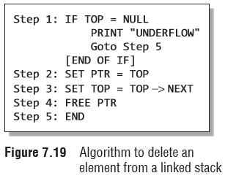


Operations on a Linked Stack
Pop Operation
Figure 7.19 shows the algorithm to delete an element from a stack.
In Step 1, we first check for the UNDERFLOW condition. In Step 2, we use a pointer PTR that points to TOP.
In Step 3, TOP is made to point to the next node in sequence.
In Step 4, the memory occupied by PTR is given back to the free pool.

Slide 21
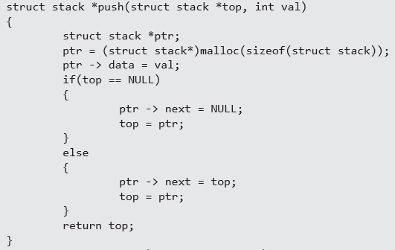
Operations on a Linked Stack

Slide 22
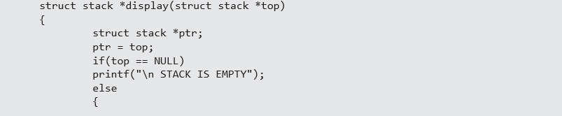
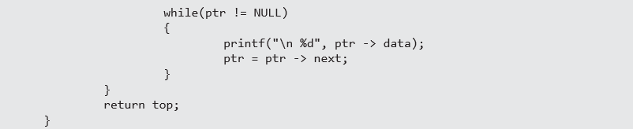
Operations on a Linked Stack

Slide 23
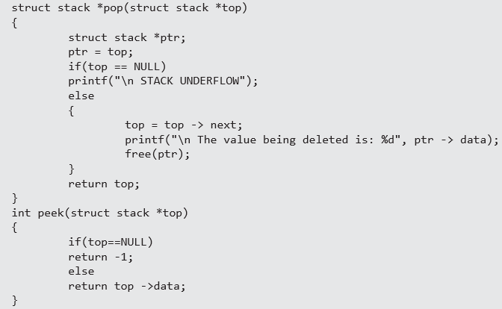
Operations on a Linked Stack

Slide 24

Multiple Stacks
While implementing a stack using an array, the size of the array must be known.
If the stack is allocated less space, then frequent OVERFLOW conditions will be encountered.
In case we allocate a large amount of space for the stack, it may result in sheer wastage of memory.
Thus, there lies a trade-off between the frequency of overflows and the space allocated.
So, a better solution to deal with this problem is to have more than one stack in the same array of sufficient size.
In Fig. 7.20, an array STACK[n] is used to represent two stacks, Stack A and Stack B.
The value of n is such that the combined size of both the stacks will never exceed n.
While operating on these stacks, it is important to note one thing—Stack A will grow from left to right, whereas Stack B will grow from right to left at the same time.

Slide 25
Applications of Stacks
Reversing a List
A list of numbers can be reversed by reading each number from an array starting from the first index and pushing it on a stack.
Once all the numbers have been read, the numbers can be popped one at a time and then stored in the array starting from the first index.

Slide 26
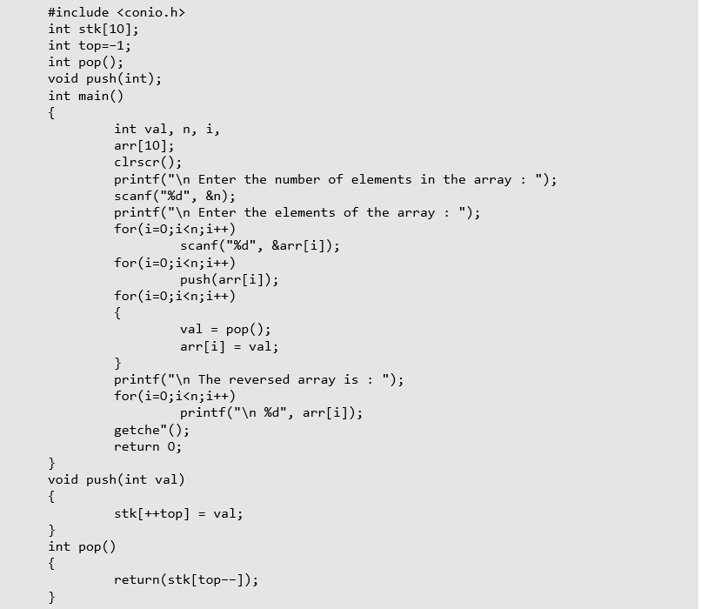
Applications of Stacks

Slide 27
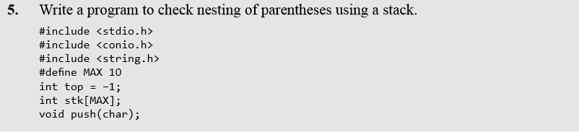
Applications of Stacks
Implementing Parentheses Checker
Stacks can be used to check the validity of parentheses in any algebraic expression.
For example, an algebraic expression is valid if for every open bracket there is a corresponding closing bracket.
For example, the expression (A+B} is invalid but an expression {A + (B – C)} is valid.
Look at the program below which traverses an algebraic expression to check for its validity.

Slide 28
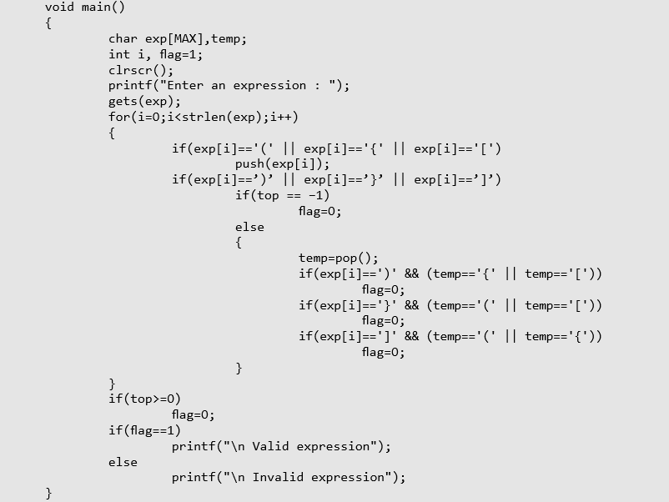
Applications of Stacks

Slide 29
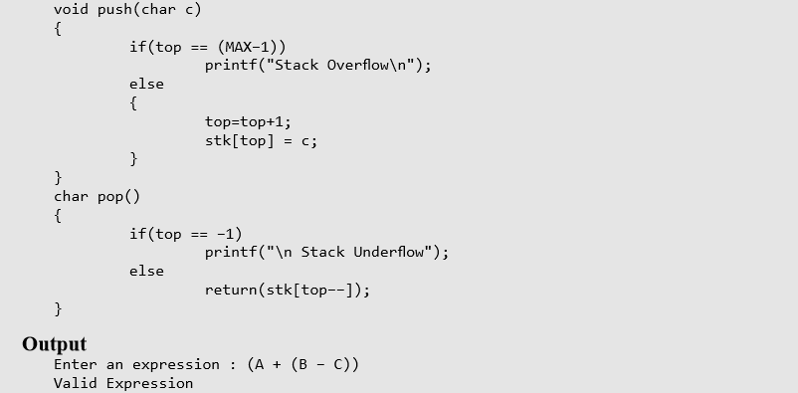
Applications of Stacks

Slide 30
Applications of Stacks
Evaluation of Arithmetic Expressions
Polish Notations
Infix, postfix, and prefix notations are three different but equivalent notations of writing algebraic expressions.
But before learning about prefix and postfix notations, let us first see what an infix notation is.
We all are familiar with the infix notation of writing algebraic expressions.
While writing an arithmetic expression using infix notation, the operator is placed in between the operands.
For example, A+B; here, plus operator is placed between the two operands A and B.
Although it is easy for us to write expressions using infix notation, computers find it difficult to parse as the computer needs a lot of information to evaluate the expression.
Information is needed about operator precedence and associativity rules, and brackets which override these rules.
So, computers work more efficiently with expressions written using prefix and postfix notations

Slide 31
Applications of Stacks
Evaluation of Arithmetic Expressions
In postfix notation, as the name suggests, the operator is placed after the operands.
For example, if an expression is written as A+B in infix notation, the same expression can be written as AB+ in postfix notation.
The order of evaluation of a postfix expression is always from left to right.
Even brackets cannot alter the order of evaluation.
The expression (A + B) * C can be written as: AB+C* in the postfix notation.

Slide 32
Applications of Stacks
Evaluation of Arithmetic Expressions
A postfix operation does not even follow the rules of operator precedence.
The operator which occurs first in the expression is operated first on the operands.
For example, given a postfix notation AB+C*.
While evaluation, addition will be performed prior to multiplication.
Thus we see that in a postfix notation, operators are applied to the operands that are immediately left to them.
In the example, AB+C*, + is applied on A and B, then * is applied on the result of addition and C.

Slide 33
Applications of Stacks
Evaluation of Arithmetic Expressions
Although a prefix notation is also evaluated from left to right, the only difference between a postfix notation and a prefix notation is that in a prefix notation, the operator is placed before the operands.
For example, if A+B is an expression in infix notation, then the corresponding expression in prefix notation is given by +AB.
While evaluating a prefix expression, the operators are applied to the operands that are present immediately on the right of the operator.
Like postfix, prefix expressions also do not follow the rules of operator precedence and associativity, and even brackets cannot alter the order of evaluation.

Slide 34
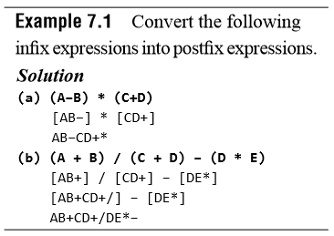
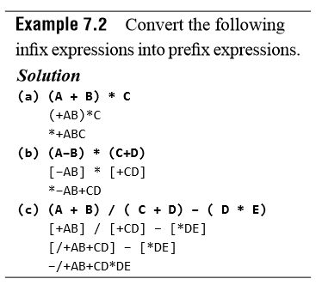
Applications of Stacks

Slide 35
Applications of Stacks
Conversion of an Infix Expression into a Postfix Expression
The algorithm given below transforms an infix expression into postfix expression, as shown in Fig. 7.22.
The algorithm accepts an infix expression that may contain operators, operands, and parentheses.
For simplicity, we assume that the infix operation contains only modulus (%), multiplication (*), division (/), addition (+), and subtraction (―) operators and that operators with same precedence are performed from left-to-right.
The algorithm uses a stack to temporarily hold operators.
The postfix expression is obtained from left-to-right using the operands from the infix expression and the operators which are removed from the stack.
The first step in this algorithm is to push a left parenthesis on the stack and to add a corresponding right parenthesis at the end of the infix expression.
The algorithm is repeated until the stack is empty.

Slide 36
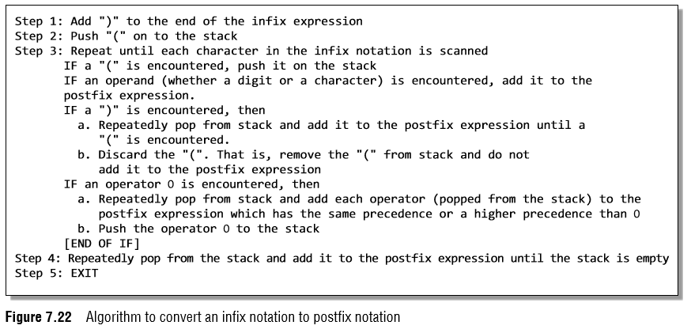
Applications of Stacks
Conversion of an Infix Expression into a Postfix Expression

Slide 37
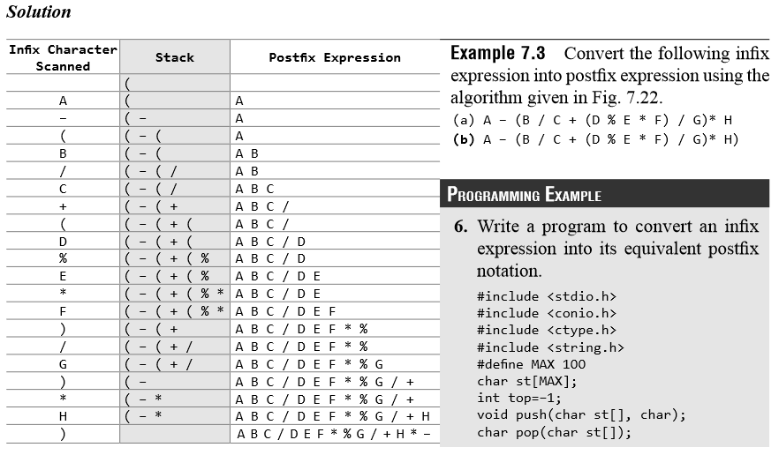
Applications of Stacks
Conversion of an Infix Expression into a Postfix Expression

Slide 38
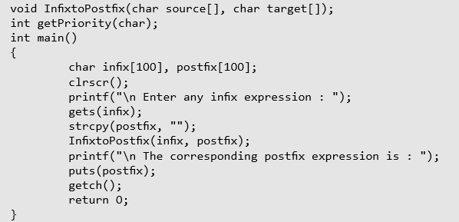
Applications of Stacks

Slide 39
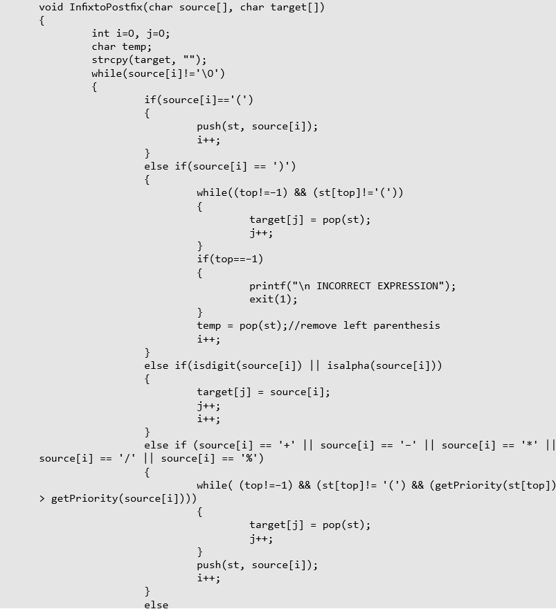
Applications of Stacks

Slide 40
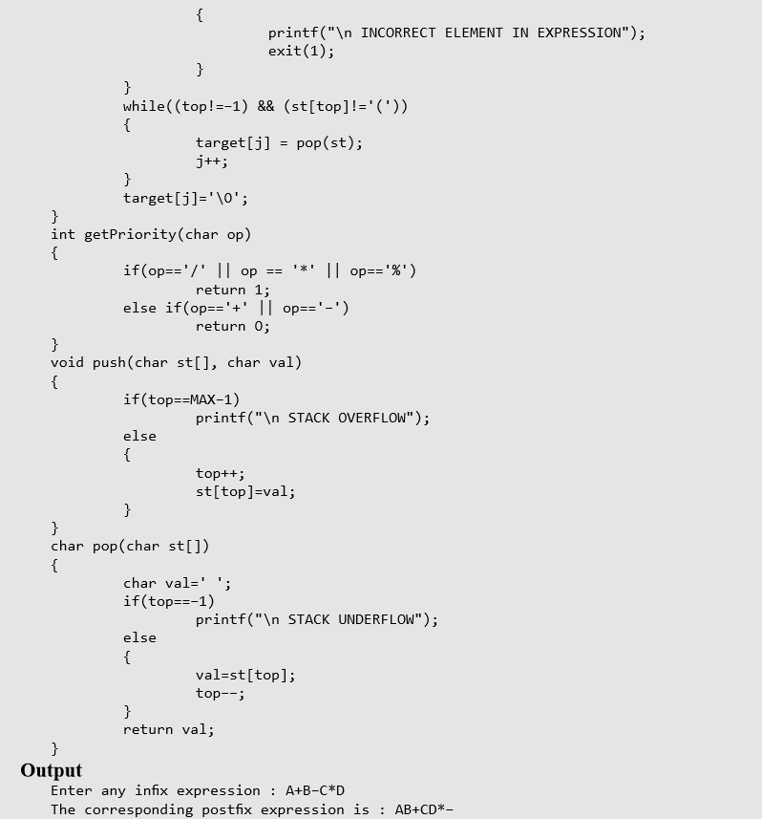
Applications of Stacks

Slide 41
Applications of Stacks
Evaluation of a Postfix Expression
The ease of evaluation acts as the driving force for computers to translate an infix notation into a postfix notation.
That is, given an algebraic expression written in infix notation, the computer first converts the expression into the equivalent postfix notation and then evaluates the postfix expression.
Both these tasks—converting the infix notation into postfix notation and evaluating the postfix expression—make extensive use of stacks as the primary tool.

Slide 42
Applications of Stacks
Evaluation of a Postfix Expression
Using stacks, any postfix expression can be evaluated very easily.
Every character of the postfix expression is scanned from left to right.
If the character encountered is an operand, it is pushed on to the stack.
However, if an operator is encountered, then the top two values are popped from the stack and the operator is applied on these values.
The result is then pushed on to the stack. Let us look at Fig. 7.23 which shows the algorithm to evaluate a postfix expression.

Slide 43
Applications of Stacks
Evaluation of a Postfix Expression
Let us now take an example that makes use of this algorithm.
Consider the infix expression given as 9 – ((3 * 4) + 8) / 4. Evaluate the expression.
The infix expression 9 – ((3 * 4) + 8) / 4 can be written as 9 3 4 * 8 + 4 / – using postfix notation.

Slide 44
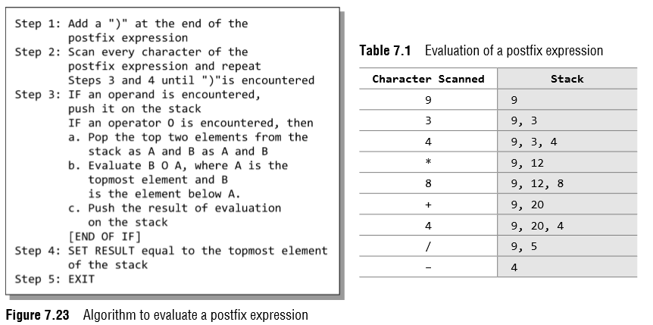
Applications of Stacks
Evaluation of a Postfix Expression
9 3 4 * 8 + 4 / –
9 3 4 * 8 + 4 / – )

Slide 45
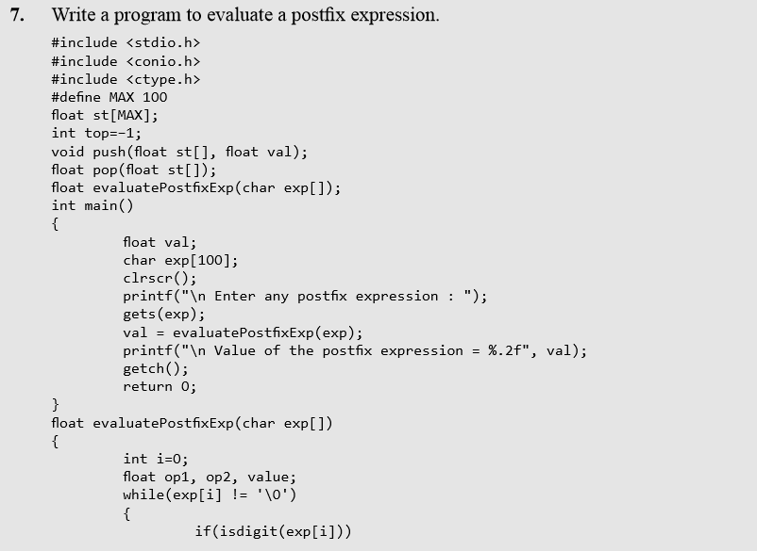
Applications of Stacks

Slide 46
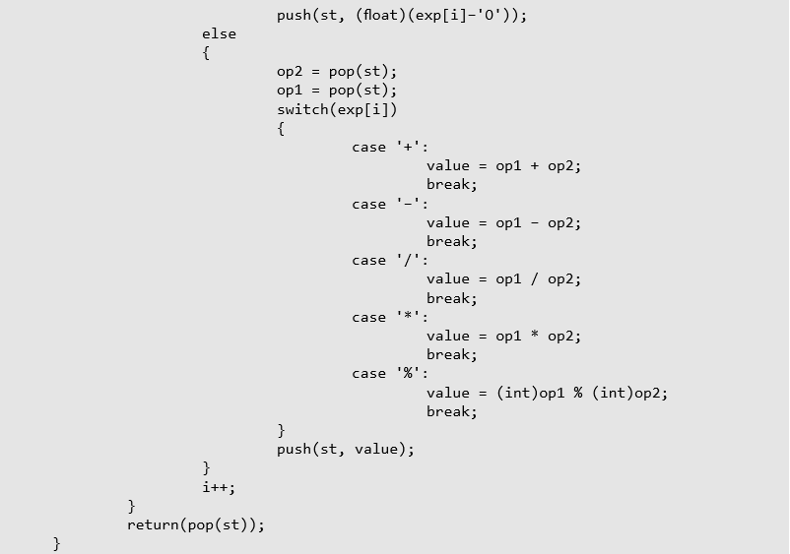
Applications of Stacks

Slide 47
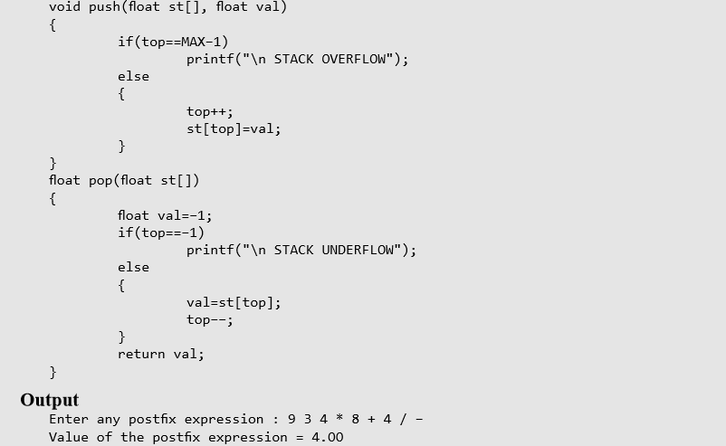
Applications of Stacks

Slide 48
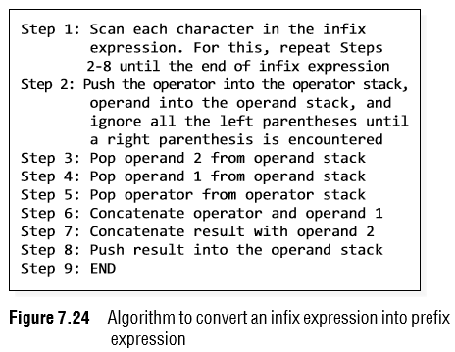
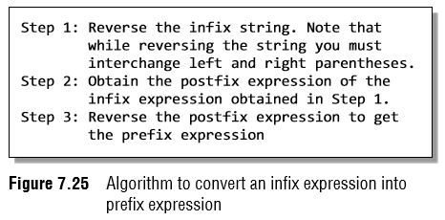
Applications of Stacks
Conversion of an Infix Expression into a Prefix Expression
There are two algorithms to convert an infix expression into its equivalent prefix expression.
The first algorithm is given in Fig. 7.24, while the second algorithm is shown in Fig. 7.25.

Slide 49
Applications of Stacks
Conversion of an Infix Expression into a Prefix Expression
Given an infix expression (A – B / C) * (A / K – L)
Step 1:Reverse the infix string. Note that while reversing the string you must interchange left and right parentheses.
(L – K / A) * (C / B – A)
Step 2:Obtain the corresponding postfix expression of the infix expression obtained as a result of Step 1.
The expression is: (L – K / A) * (C / B – A)
[L – (K A /)] * [(C B /) – A]
= [LKA/–] * [CB/A–]
= L K A / – C B/A – *
Step 3:Reverse the postfix expression to get the prefix expression
* – A / B C – /A K L

Slide 50
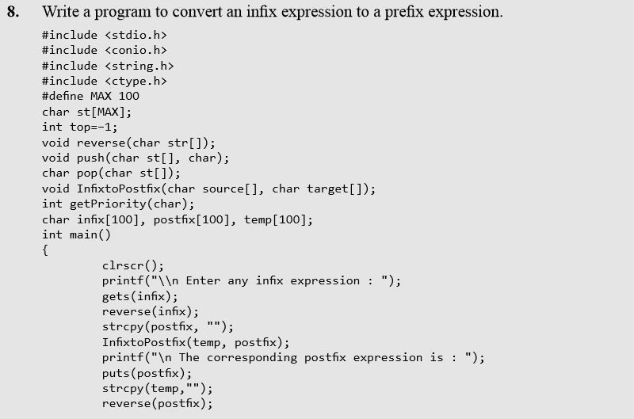
Applications of Stacks

Slide 51
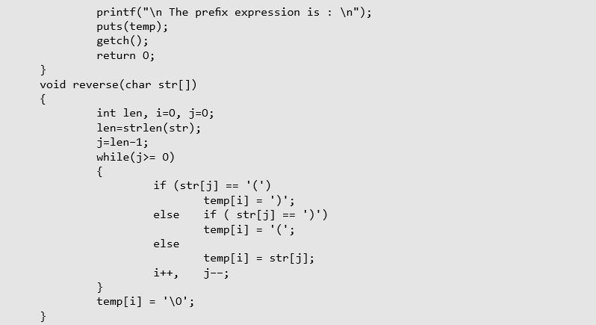
Applications of Stacks

Slide 52
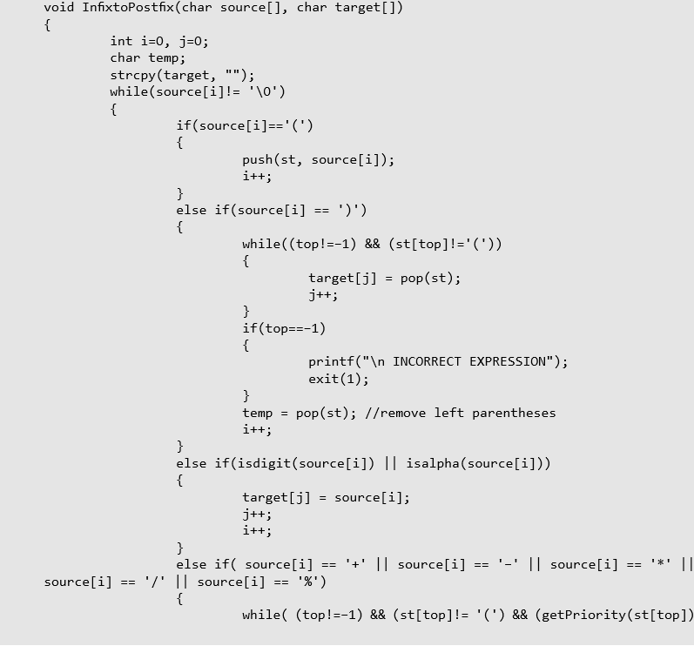
Applications of Stacks

Slide 53
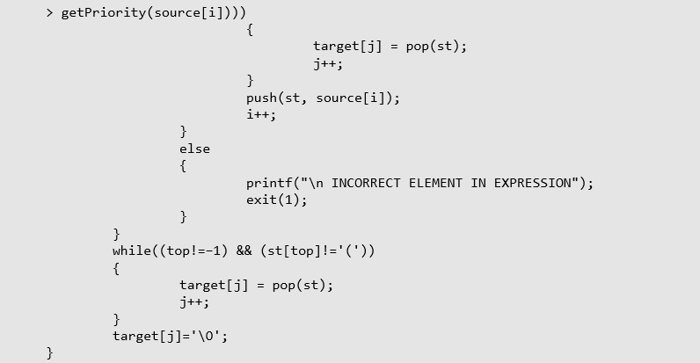
Applications of Stacks

Slide 54
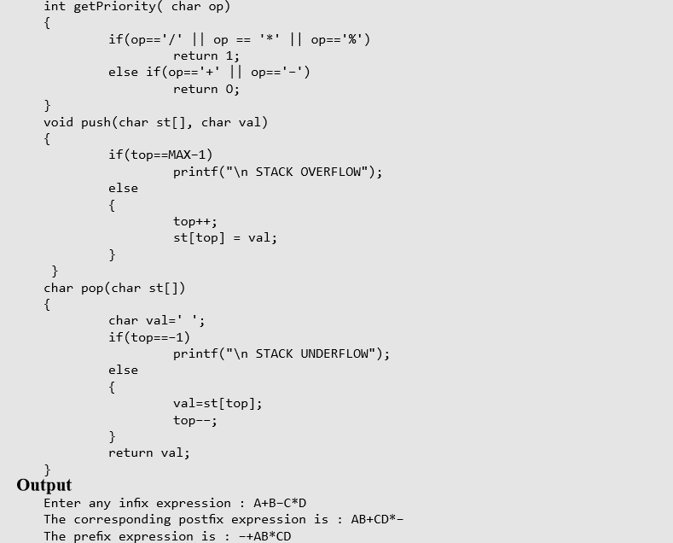
Applications of Stacks

Slide 55
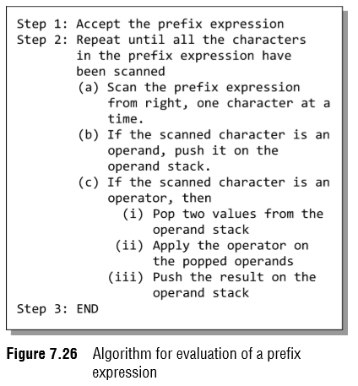
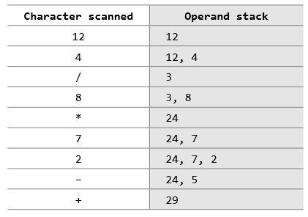
Applications of Stacks
Evaluation of a Prefix Expression
The way of evaluation of a prefix expression is given in Fig. 7.26.
For example, consider the prefix expression + – 9 2 7 * 8 / 4 12.
Let us now apply the algorithm to evaluate this expression.

Slide 56
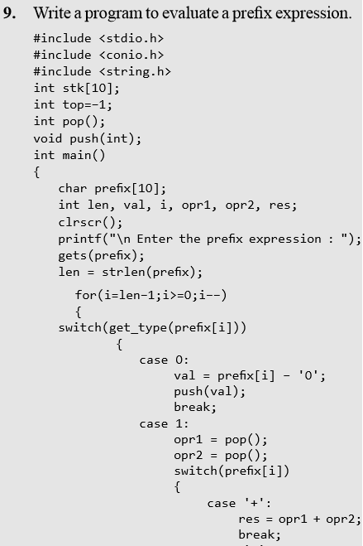
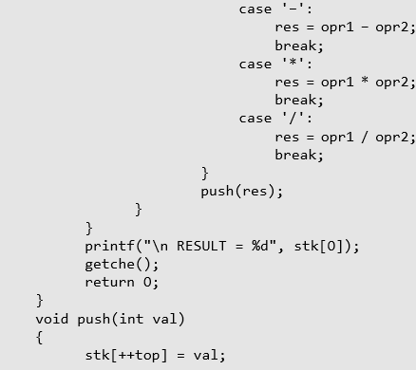
Applications of Stacks

Slide 57
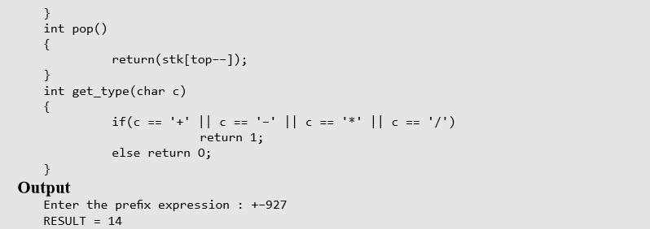
Applications of Stacks

